Slide 1
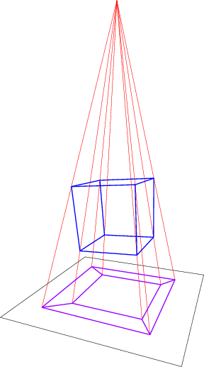
2 – Analysing High-Dimensional Data
Credit: https://math.stackexchange.com/q/2286226

Slide 2
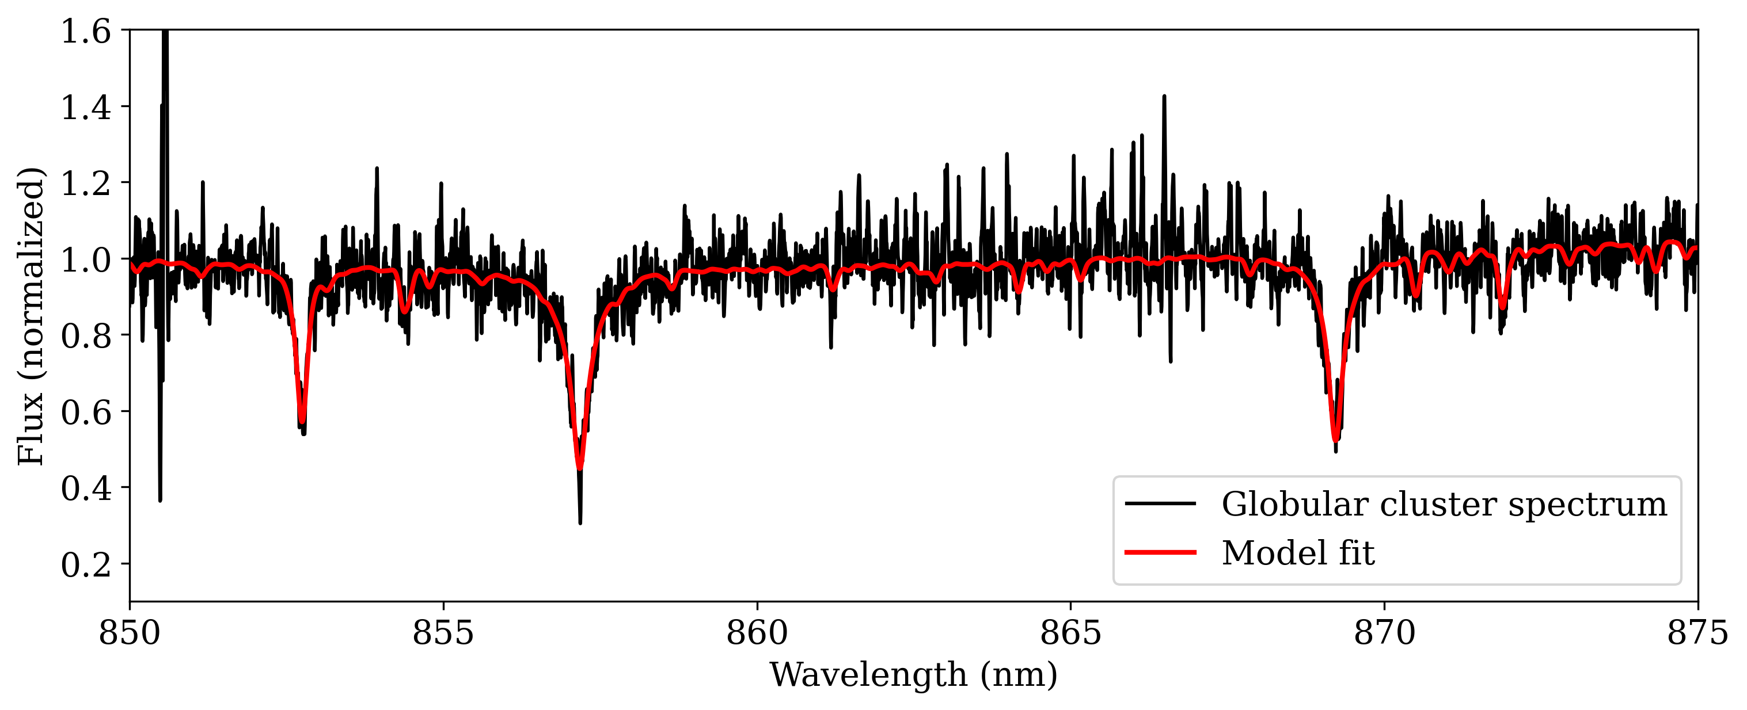
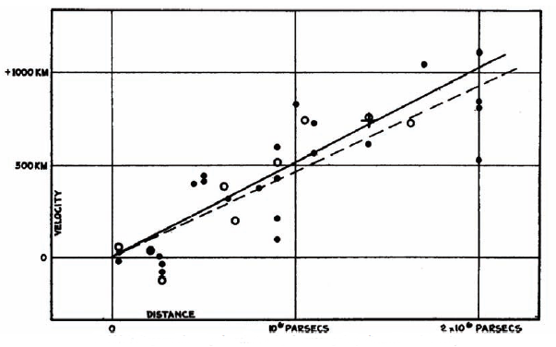
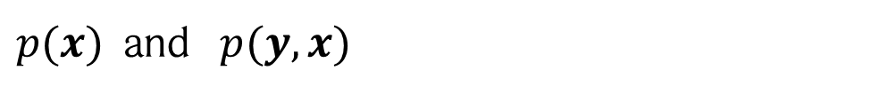

Why did we look so much at statistics?
One reason: data can be interpreted as samples from an underlying distribution!
Hubble law: redshift vs distance
d
Our data follows an underlying distribution $p(x)$,
and measurements are samples from that distribution!
Usually two cases are distinguished:
$p(x)$ and $p(y, x)$
data
labels
In the following, we start with the former!
Image: Hubble, Proceedings of the National Academy of Sciences, 1929, 15, 168

Slide 3
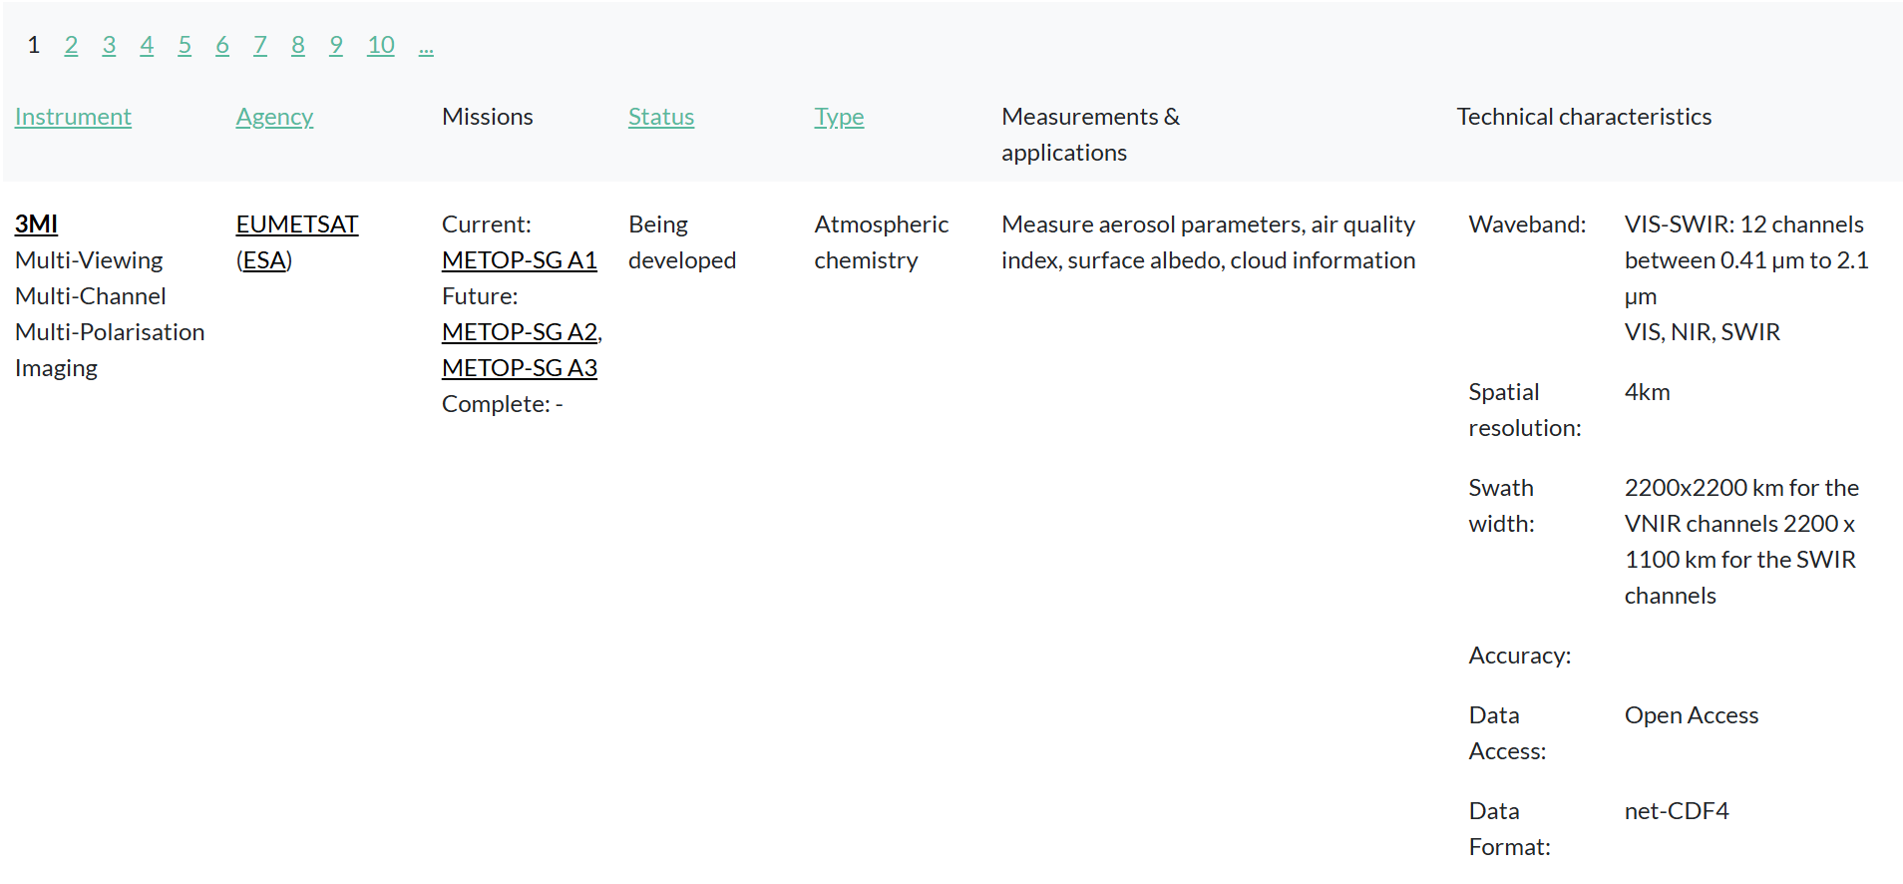
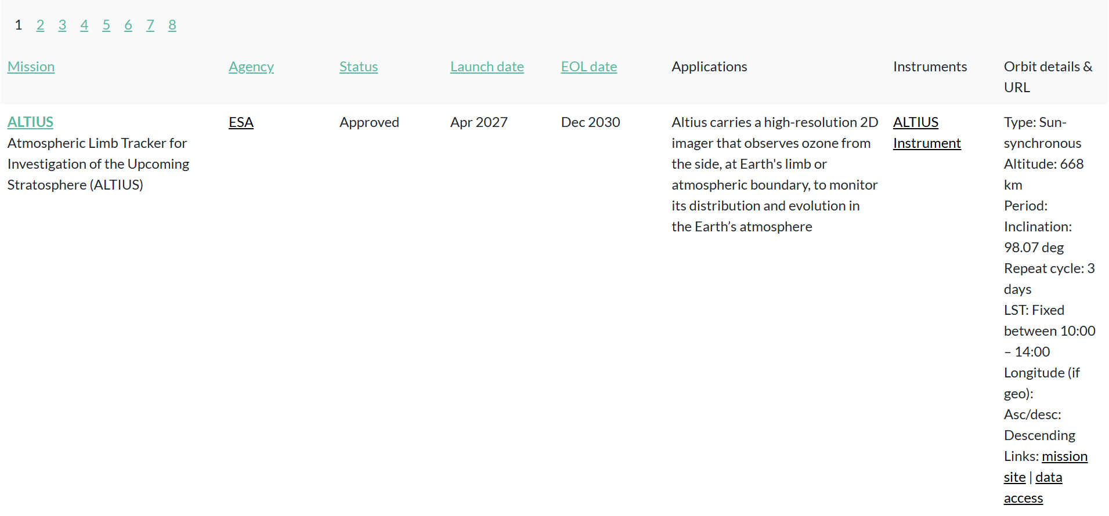
Motivation: making sense of (unlabeled) data
In this lecture block, we will approach the following three challenges:
1. The data is very high-dimensional
2. We only have a finite number of samples
Very unintuitive domain!
Hard to visualize!
Hard to tell which features are actually important (contain information)
Noise vs. signal!
3. We have no labels
How can we detect useful structure in the data?
More examples of such data (taken from https://database.eohandbook.com/):

Slide 4
Content
The curse and blessing of high dimensions
Eigenvalue decomposition, Determinant
Principal component analysis
Marcenko-Pastur distribution
Johnson-Lindenstrauss Lemma
K-Means clustering
DBSCAN
Graphs
Spectral clustering
Diffusion Maps

Slide 5

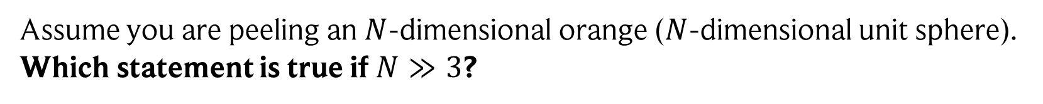
“Fun in high dimensions” quiz: question 1
Assume you are peeling an $N$-dimensional orange ($N$-dimensional unit sphere). Which statement is true if $N≫3$?
After peeling, most of the orange is gone.
After peeling, most of the orange is left.
Image: https://www.vecteezy.com/vector-art/28271475-orange-fruit-peeling-skin-illustration-with-leaves-sketch-drawing-vector-design, August 2025

Slide 6

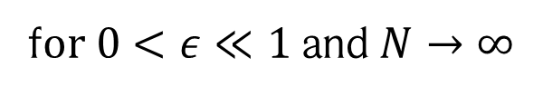

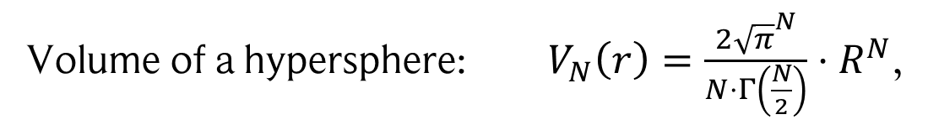
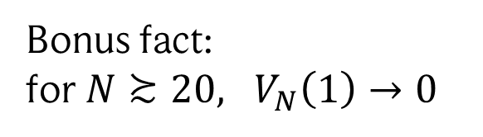
“Fun in high dimensions” quiz: question 1
Assume you are peeling an $N$-dimensional orange ($N$-dimensional unit sphere). Which statement is true if $N≫3$?
After peeling, most of the orange is gone.
After peeling, most of the orange is left.
Volume of a hypersphere: $V_{N}\left(r\right)=\frac{2{\sqrt{π}}^{N}}{N⋅Γ\left(\frac{N}{2}\right)}⋅R^{N}$,
$$Γ\left(z\right)=\int_{0}^{∞}{t^{z−1}e^{−t}dt}=\left(z−1\right)!$$
Gamma function
Volume ratio near surface: $\frac{V_{N}\left(1−ε\right)}{V_{N}\left(1\right)}={\left(1−ε\right)}^{N}→0$
Bonus fact: for$N≿20, V_{N}\left(1\right)→0$
f$or 0<ε≪1$ and $N→∞$

Slide 7
“Fun in high dimensions” quiz: question 2
Assume a little unit square (2D box) contained in the unit circle (2D sphere). What happens if you increase the dimension?
The box stays inside the sphere.
The box spills out of the sphere.
Both occupy the same volume.
Unit box
Unit sphere

Slide 8


“Fun in high dimensions” quiz: question 2
Assume a little unit square (2D box) contained in the unit circle (2D sphere). What happens if you increase the dimension?
The box stays inside the sphere.
The box spills out of the sphere.
Both occupy the same volume.
Unit box
We can show this using statistics!
Unit sphere
1) Sample a random point $z$ using a uniform distribution $U\left({\left[−0.5, 0.5\right]}^{N}\right)$.
2) We seek the probability of $z$ to be inside the sphere: $P\left({\left\|z\right\|}_{2}^{2}<1\right)$ in the limit of large $N≫12.$
3) This is given by the one-sided Hoeffding inequality using $E\left(z_{i}^{2}\right)=\frac{1}{12}$
$$P\left({\left\|z\right\|}_{2}^{2}≤1\right)=P\left(\sum_{i}{z_{i}^{2}}≤1\right)=P\left(\frac{1}{N}\sum_{i}{\left(z_{i}^{2}\right)−E\left(z_{0}^{2}\right)≤\frac{1}{N}−\frac{1}{12} }\right)≤e^{−\frac{16N}{72}}$$
$$<0$$

Slide 9
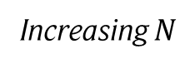
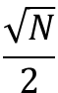
“Fun in high dimensions” quiz: question 2
Thus, for large $N$ almost all points end up outside of the sphere!
Why? Mid-points of sides (e.g., $\left(0.5,0,0,0,0\right)$ for $N =5$) are within the sphere, but corners (e.g., $(0.5,0.5,0.5,0.5,0.5)$) are outside! Thus, most volume is in the corners!
$$\frac{\sqrt{N}}{2}$$
Increasing $N$
Images: Bandaira-Singer-Strohmer, Mathematics of Data Science

Slide 10
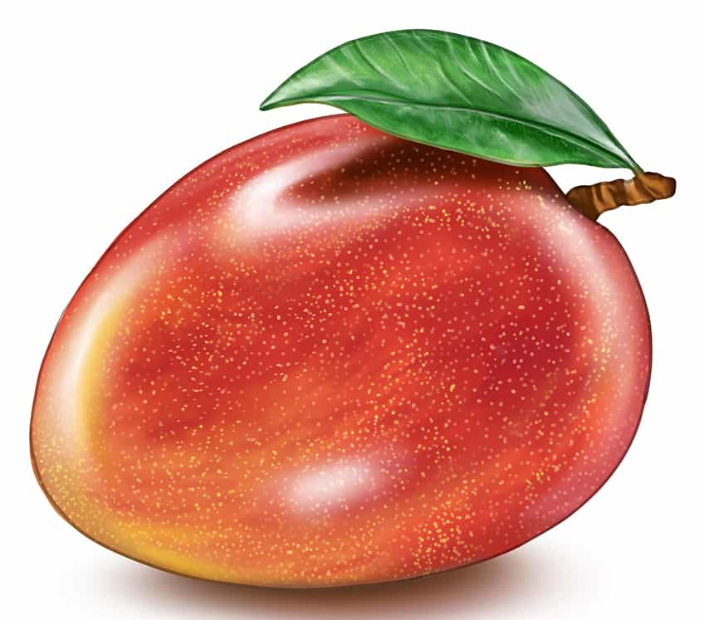
“Fun in high dimensions” quiz: last question
Let’s assume a $d$-dimensional, spherical Mango. How much of the top and bottom can you cut off until most of the Mango is gone?
A)
B)
C)
Image: https://artincontext.org/how-to-draw-a-mango/, September 2025

Slide 11
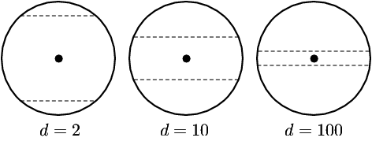
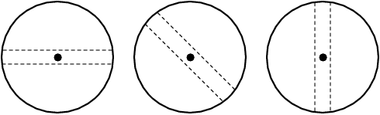
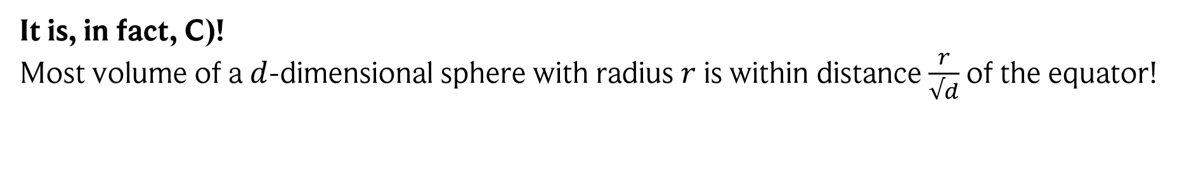
“Fun in high dimensions” quiz: last question
Let’s assume a $d$-dimensional, spherical Mango. How much of the top and bottom can you cut off until most of the Mango is gone?
C)
It is, in fact, C)!
Most volume of a $d$-dimensional sphere with radius $r$ is within distance $\frac{r}{√d}$of the equator!
Extra weirdness (don’t ask me!): This applies to ALL equators…
Images: https://people.eecs.berkeley.edu/~jrs/highd/, September 2025

Slide 12
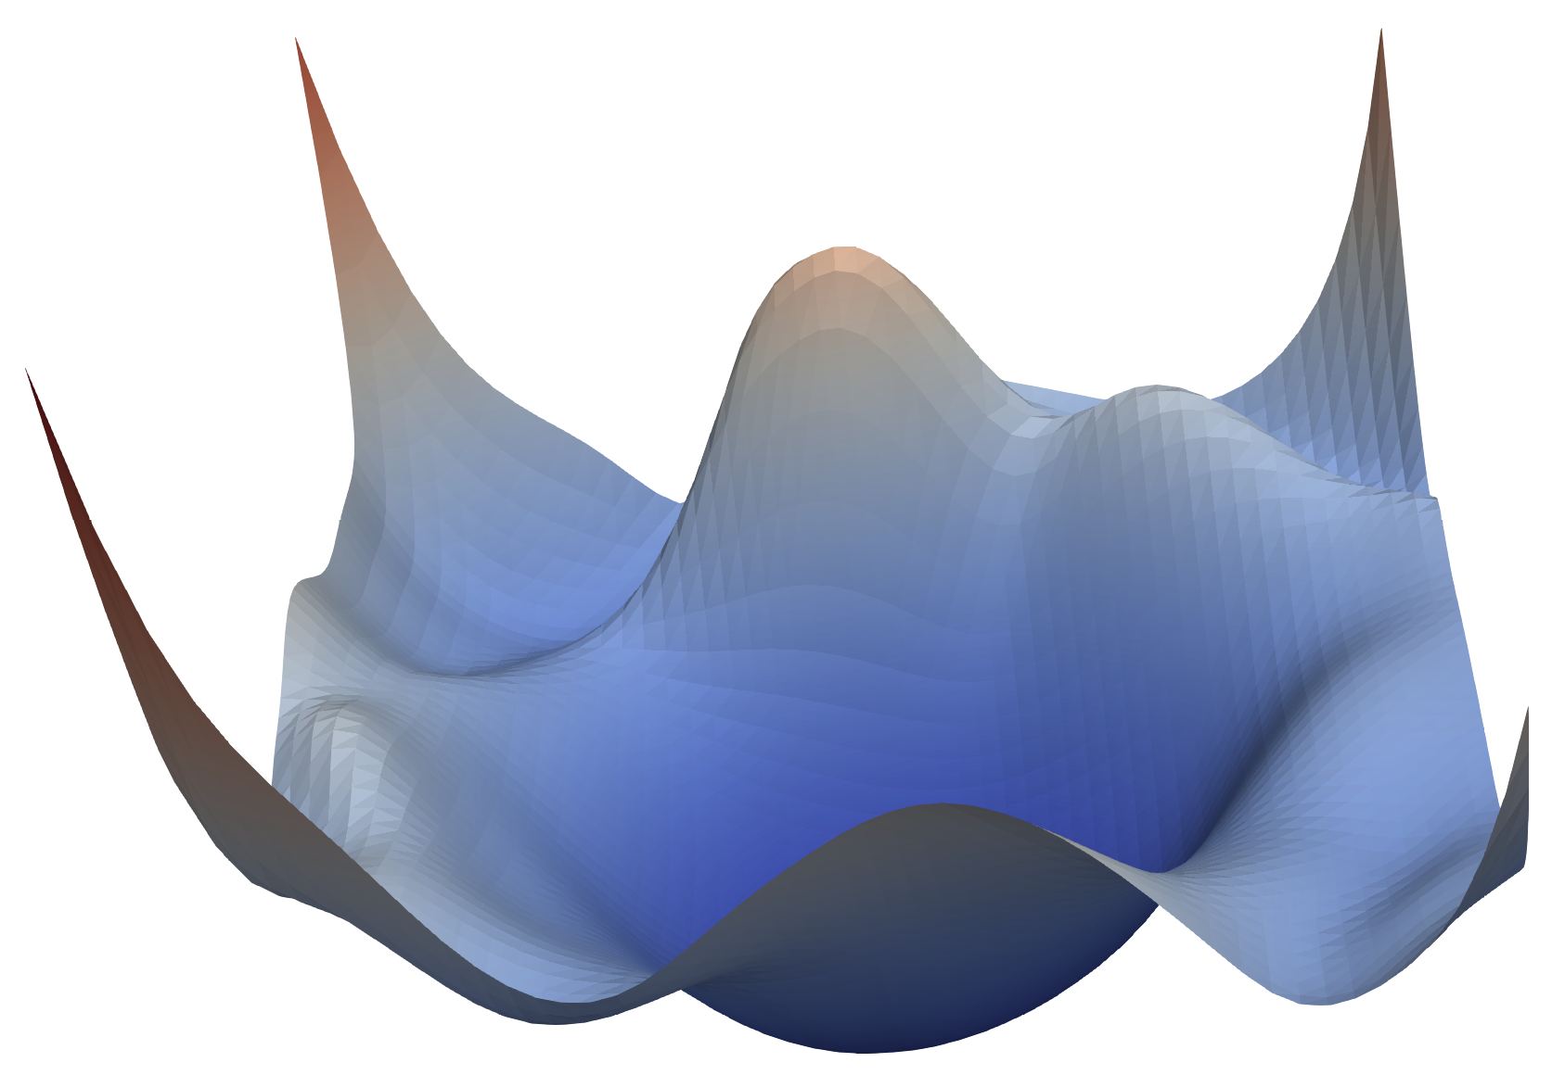
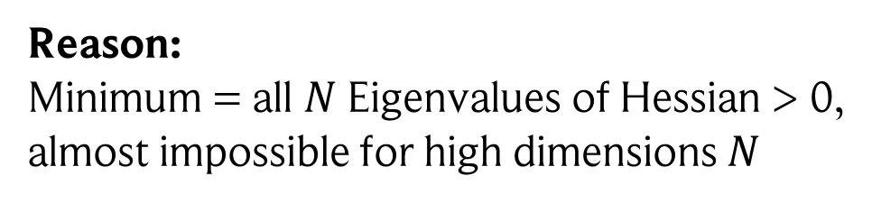
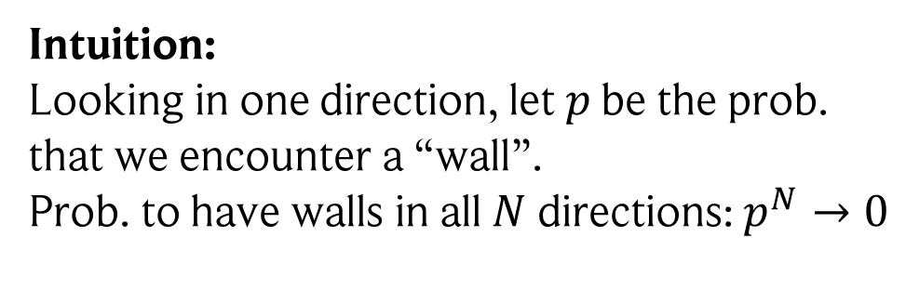
The blessing of dimensionality
Optimizing parameters of a neural network
= following gradients on an error landscape
Concern in low dimensions:
Getting stuck in local (non-optimal) minima.
Good solution? Minimal error!
In high dimensions (case of neural nets):
Almost all extrema are saddle points!
Reason: Minimum = all $N$ Eigenvalues of Hessian > 0, almost impossible for high dimensions $N$
Intuition: Looking in one direction, let $p$ be the prob. that we encounter a “wall”. Prob. to have walls in all $N$ directions: $p^{N}→0$
Image: https://www.cs.umd.edu/~tomg/projects/landscapes/, August 2025

Slide 13

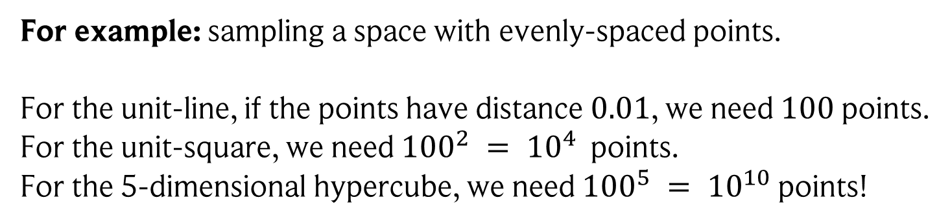
The curse of dimensionality (actually called like this!)
Many operations do not scale well with high dimensions!
For example: sampling a space with evenly-spaced points.
For the unit-line, if the points have distance $0.01$, we need $100$ points. For the unit-square, we need ${100}^{2} = {10}^{4}$ points.
For the 5-dimensional hypercube, we need ${100}^{5} = {10}^{10}$ points!
Exponential explosion!
Another example: high-dimensional data, meaning we pad together many features.
When training models, one might think having more features (higher data dim.) is better. However, when increasing the number of features linearly, the density of our training data reduces exponentially! Thus, our data is not representative anymore and we risk overfitting.

Slide 14
The manifold hypothesis
Manifold hypothesis: many high-dimensional data that occurs in the real-world populates a low-dimensional manifold.
Roughly: in practice, “quality” high-dimensional data contains “(simple) structures” that we can use to answer questions about the data (or not, then we have to collect better data).
Or in other terms: the data can be “compressed” to lower dimensions with minimal loss.
Note: this is just a hypothesis. But without structure, we cannot do anything anyways!

Slide 15
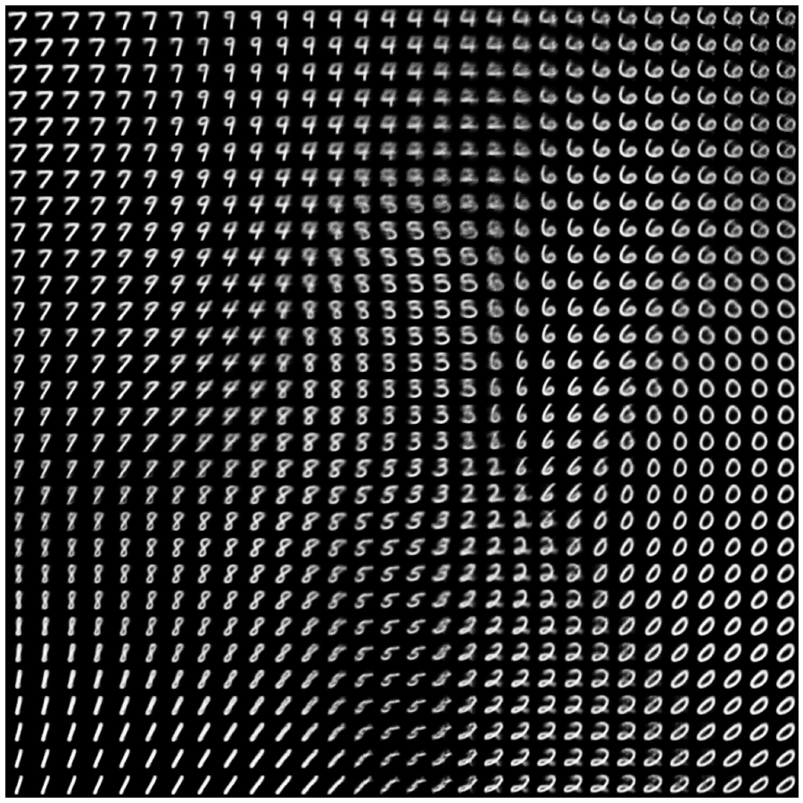
Examples
Example 1: MNIST handwritten digits dataset can be reduced to two dimensions while keeping a lot of structure (image credit: François Chollet).

Slide 16
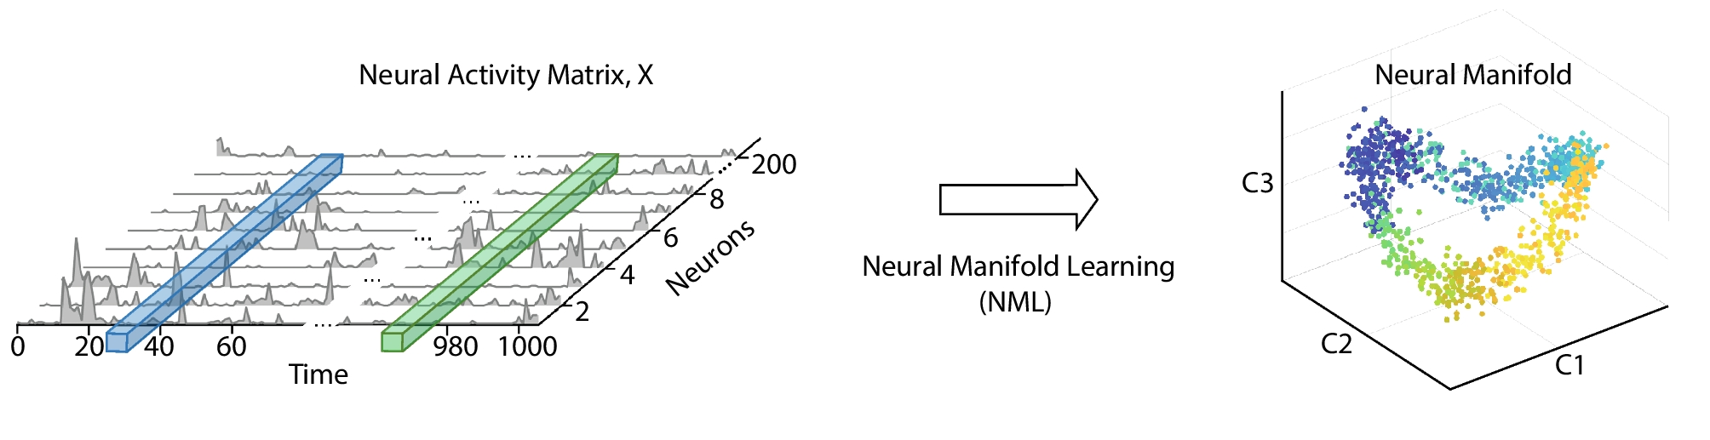
Examples
Example 1: MNIST handwritten digits dataset can be reduced to two dimensions while keeping a lot of structure (image credit: François Chollet).
Example 2: neural data is incredibly high-dimensional (lots and lots of neurons), but neural activity itself often lies on a low-dimensional manifold!
Image DOI: 10.1007/s10827-022-00839-3

Slide 17


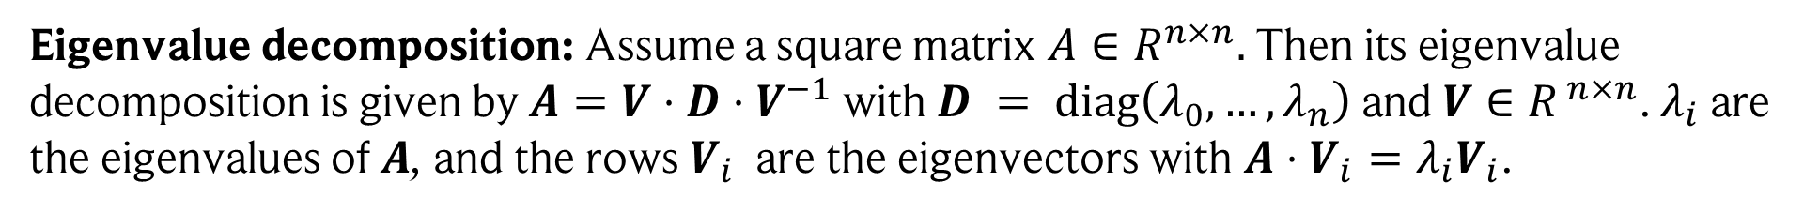



Towards dimensionality reduction: a refresher
Eigenvalues and eigenvectors: Assume a square matrix $A∈R^{n×n}, n∈ℕ.$ Then $A$ has eigenvalue$λ$ with eigenvector $v$ if $Av=λv$, i.e., $A$ merely rescales $v$ by $λ$.
Eigenvalue decomposition: Assume a square matrix $A∈R^{n×n}.$ Then its eigenvalue decomposition is given by $A=V⋅D⋅V^{−1}$ with $D = diag\left(λ_{0},…,λ_{n}\right)$ and $V∈R^{ n×n}$. $λ_{i}$ are the eigenvalues of $A$, and the rows $V_{i}$ are the eigenvectors with ${A⋅V}_{i}=λ_{i}V_{i}$.
$V:$ basis change from eigenvectors to unit vectors $e_{i} = \left(0,…,1,…,0\right)$
${\left(\begin{matrix}a_{0} \\ a_{1}\end{matrix}\right)}_{V}$ $=a_{0}\left(\begin{matrix}V_{00} \\ V_{10}\end{matrix}\right)+a_{1}\left(\begin{matrix}V_{01} \\ V_{11}\end{matrix}\right)=\left(\begin{matrix}V_{00} & V_{01} \\ V_{10} & V_{11}\end{matrix}\right)⋅ \left(\begin{matrix}a_{0} \\ a_{1}\end{matrix}\right)=\left(a_{0}V_{00}+a_{1}V_{10}\right)\left(\begin{matrix}1 \\ 0\end{matrix}\right)+\left(a_{0}V_{10}+a_{1}V_{11}\right)\left(\begin{matrix}0 \\ 1\end{matrix}\right)$
$$V_{0}$$
$$V_{1}$$
$$V$$
$$e_{0}$$
$$e_{1}$$
$V^{−1}:$ basis change from unit vectors to eigenvectors
Thus: $V⋅D⋅V^{−1}u=$ represent vector $u$ in eigenbasis ${u^{′}=V}^{−1}u$, in eigenbasis $A$ only stretches the eigenvectors $u^{′′}=Du′$, then transform back to the original basis $Au=Vu′′$.

Slide 18

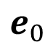
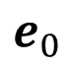
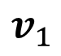
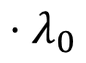
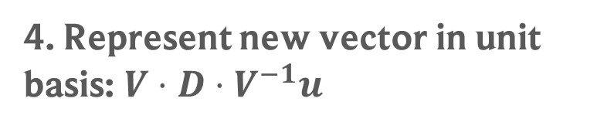

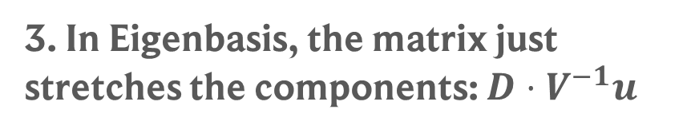
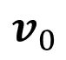
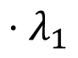


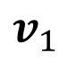
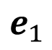
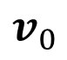
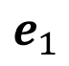
Visualisation of $A⋅u =V⋅ D⋅ V^{−1}⋅u$
$$e_{1}$$
$$v_{1}$$
$$u$$
$$u$$
$$v_{0}$$
$$e_{0}$$
1. Vector in unit basis
2. Represent vector in Eigenbasis: $V^{−1}u$
$${⋅λ}_{0}$$
$$e_{1}$$
$$v_{1}$$
$${⋅λ}_{1}$$
$$v_{0}$$
$$e_{0}$$
3. In Eigenbasis, the matrix just stretches the components: $D⋅V^{−1}u$
4. Represent new vector in unit basis: $V⋅D⋅V^{−1}u$

Slide 19
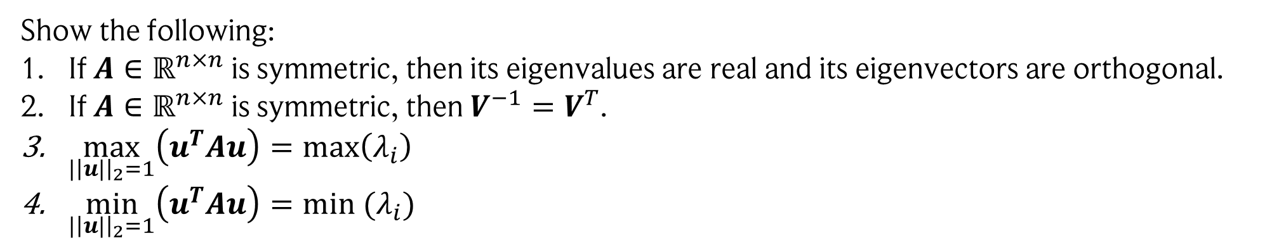
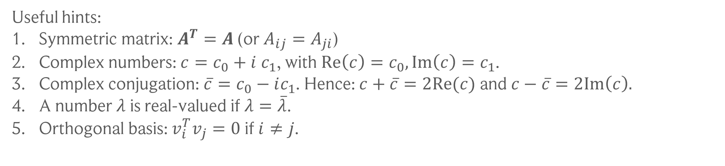
Exercise time
Show the following:
If $A∈ℝ^{n×n}$ is symmetric, then its eigenvalues are real and its eigenvectors are orthogonal.
If $A∈ℝ^{n×n}$ is symmetric, then $V^{−1}=V^{T}$.
$\max_{|{\left|u|\right|}_{2}=1}\left(u^{T}Au\right)=max\left(λ_{i}\right)$
$\min_{|{\left|u|\right|}_{2}=1}\left(u^{T}Au\right)=min (λ_{i})$
Useful hints:
Symmetric matrix: $A^{T}=A$ (or $A_{ij}=A_{ji}$)
Complex numbers: $c=c_{0}+i c_{1}$, with $Re\left(c\right)=c_{0}, Im\left(c\right)=c_{1}$.
Complex conjugation: $\overline{c}=c_{0}−ic_{1}$. Hence: $c+\overline{c}=2Re(c)$ and $c−\overline{c}=2Im\left(c\right).$
A number $λ$ is real-valued if $λ=\overline{λ}$.
Orthogonal basis: $v_{i}^{T}v_{j}=0$ if $i≠j$.
Useful case: Assume a real-valued symmetric matrix $A∈R^{n×n}.$ Then $A$ has an eigenvalue decomposition with real-valued eigenvalues:$A = V⋅ D⋅ V^{T}$ and $V^{T}V=1$.

Slide 20
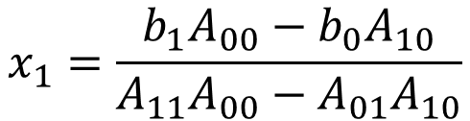
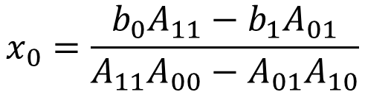

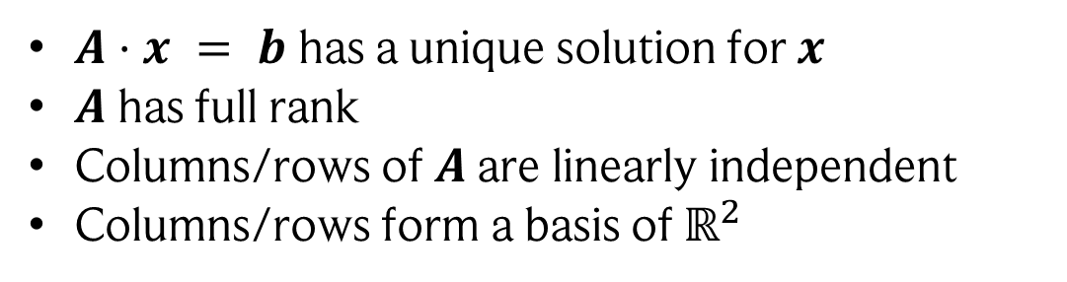


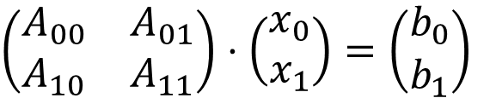
To get Eigenvalues, we need… the determinant
The determinant is always a bit hard to digest, but it has a surprisingly simple origin!
Let’s try to solve the following system of linear equations: $A⋅x = b$
$$x_{0}=\frac{b_{0}A_{11}−b_{1}A_{01}}{A_{11}A_{00}−A_{01}A_{10}}$$
$\left(\begin{matrix}A_{00} & A_{01} \\ A_{10} & A_{11}\end{matrix}\right)⋅\left(\begin{matrix}x_{0} \\ x_{1}\end{matrix}\right)=\left(\begin{matrix}b_{0} \\ b_{1}\end{matrix}\right)$
R$ewrite:$
T$his is solved by:$
(see written notes)
$$x_{1}=\frac{b_{1}A_{00}−b_{0}A_{10}}{A_{11}A_{00}−A_{01}A_{10}}$$
We define $A_{11}A_{00}−A_{01}A_{10}$ as the determinant of $A,\det\left(A\right),$ for $A∈ℝ^{2×2}$
Interpretation? If $\det\left(A\right)≠0$, then
$A⋅x = b$ has a unique solution for $x$
$A$ has full rank
Columns/rows of $A$ are linearly independent
Columns/rows form a basis of $ℝ^{2}$

Slide 21
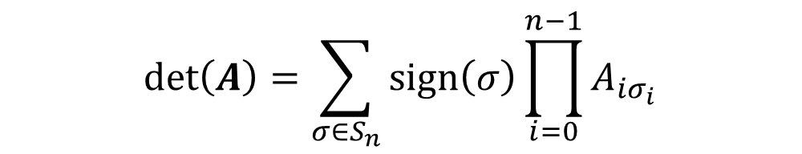
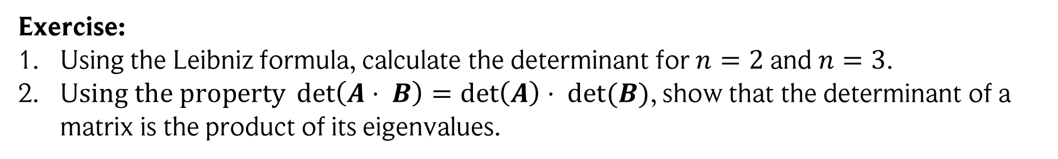
The determinant in higher dimensions
The same “derivation” is true for higher dimensions as well!
$$\det\left(A\right)=\sum_{σ∈S_{n}}{sign\left(σ\right)\prod_{i=0}^{n−1}{A_{iσ_{i}}}}$$
For $A∈ℝ^{n×n}$, the determinant is given by (Leibniz formula):
$S_{n}:$ permutations of n elements, e.g., $S_{n}=(\left(0,1\right), \left(1,0\right))$
$sign\left(σ\right):$ 1 for even number of permutations, -1 otherwise, e.g., sign$\left(\left(1,0\right)\right)=−1$
Exercise:
Using the Leibniz formula, calculate the determinant for $n=2$ and $n=3$.
U$sing the property\det\left(A⋅ B\right)=\det\left(A\right)⋅ det⁡(B)$, show that the determinant of a matrix is the product of its eigenvalues.

Slide 22
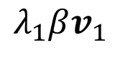
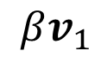
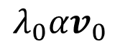
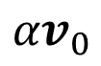
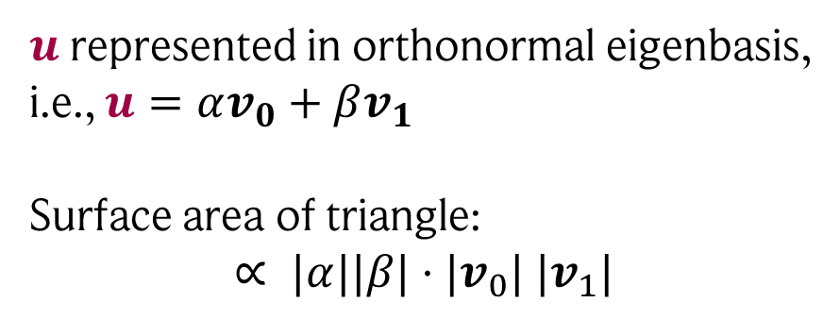
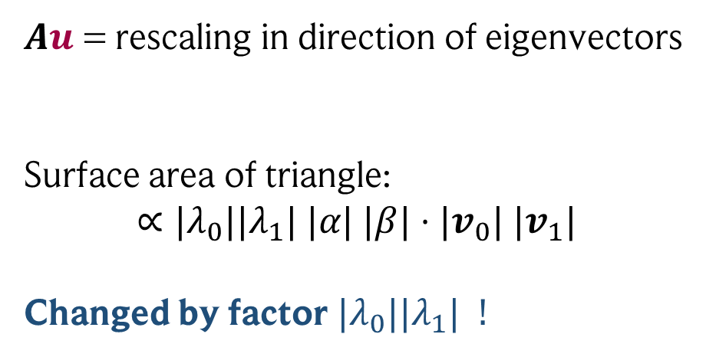
Determinant = change in volume through linear map!
This is especially nice to see using the eigenbasis of matrix $A$
$$Au$$
$$u$$
$$βv_{1}$$
$$λ_{1}βv_{1}$$
$${αv}_{0}$$
$${λ_{0}αv}_{0}$$
$u$ represented in orthonormal eigenbasis,
i.e., $u=αv_{0}+βv_{1}$
Surface area of triangle: $$∝ |α||β|⋅|v_{0}| |v_{1}|$$
$Au$ = rescaling in direction of eigenvectors
Surface area of triangle: $$∝|λ_{0}||λ_{1}| |α| |β|⋅|v_{0}| |v_{1}|$$
Changed by factor $|λ_{0}||λ_{1}| !$

Slide 23

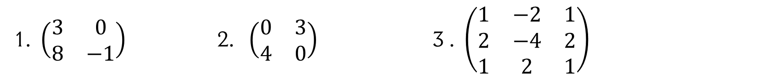

Last step: calculating eigenvalues and eigenvectors
Reminder:
We want $Av=λv$, or in other terms: $(A−1λ)v=0$
This is a system of linear equations!
Obviously, this is solved by $v=0$ if det($A−1λ)≠0$
Find non-trivial solution: require det($A−1λ)=0$
Thus, there are two steps:
Get eigenvalues by solving det($A−1λ)=0$
Use eigenvalue $λ_{i}$to solve for $v_{i}≠0$, ($A−1λ_{i})v_{i}=0$
Exercises:
Calculate the eigenvalues and eigenvectors of the following matrices
1. $\left(\begin{matrix}3 & 0 \\ 8 & −1\end{matrix}\right)$ 2. $\left(\begin{matrix}0 & 3 \\ 4 & 0\end{matrix}\right)$ 3 . $\left(\begin{matrix}1 & −2 & 1 \\ 2 & −4 & 2 \\ 1 & 2 & 1\end{matrix}\right)$

Slide 24



Dimensionality reduction
Setting: Assume we are faced with high-dimensional data. A common approach is to reduce the number of dimensions to $d$, i.e., to find a representation that uses only a small number of meaningful features. This is often done as a preprocessing step before using other methods such as clustering, which work better in low dimensions.
Principal Component Analysis (PCA) is the goat (greatest of all time) of dimensionality reduction. It is principled, simple, and especially useful for visualizing data in 2D and 3D.
The goal of PCA is to project the data into a $d−$dimensional subspace such that directions with highest feature variance are kept.
Image: https://www.ibm.com/think/topics/principal-component-analysis, September 2025

Slide 25




Principal component analysis (PCA)
Karl Pearson (1857 - 1936)
PCA: Given data samples $x_{0},…,x_{N}∈ℝ^{n}$, the columns of the projection $V∈ℝ^{n×d}$ are given by the $d$ eigenvectors of the covariance matrix
with the highest eigenvalues. The projected data is given by $y_{i}=V^{T}x_{i}∈ℝ^{d} \left(d<n\right).$
$$Σ=\frac{1}{n−1}\sum_{i=1}^{n}{\left(x_{i}−μ\right){\left(x_{i}−μ\right)}^{T}}, μ=\frac{1}{n}\sum_{i}^{n}{x_{i}}$$
The objective that PCA optimizes can be formulated in two different ways:
As we just said: finding a projection that conserves as much variance in the data as possible.
Finding a $d$-dimensional affine subspace for which the projected points best resemble the original ones, $x_{i}≈μ+Vy_{i}$, with constant $μ∈ℝ^{n}$.
The solutions are identical up to a constant offset $V^{T}μ$.
Proof: see handwritten notes

Slide 26



Example: using PCA on the original Pokemon
PC1
PC2

Slide 27


Example: randomly perturb $y_{i}$ u$ntil{ x}_{i}≈μ+Vy_{i}$

Slide 28



Example: using components with less variance
PC3
PC4

Slide 29



Example: using components with less variance
PC5
PC6
Note: The first and second eigenvalue are by far the largest!

Slide 30

Which target dimension to pick for PCA?
For visualization, we obviously pick $d = 2$or $d =3$.
But PCA is also useful in other applications!
Denoising
Downstream analysis: use lower-dim. representation as input for another method
From the Pokemon example
Any ideas how to choose the dimension?
“elbow”
Popular heuristic: look at eigenvalues,
is there an “elbow” point?

Slide 31

Question!
I have 2000 data samples, with each sample having a dimension of 2000.
Now I calculate the covariance matrix and look at its eigenvalues.
Does this data have a specific low-dimensional structure?

Slide 32



Spectrum of covariance matrices for finite sample sizes
Assume our data $x$ is generated from a $d$-dimensional Gaussian distribution:
$$p\left(x\right)=\frac{1}{{\left(2π\right)}^{d/2} \sqrt{det⁡(Σ)}}e^{−\frac{1}{2}{\left(x−μ\right)}^{T}Σ^{−1}(x−μ)}$$
$μ$: mean
$Σ:$ covariance matrix
If we have $n$ samples $x_{n}$, we can approximate the covariance matrix via:
$$Σ_{n}=\frac{1}{n−1}\sum_{k=1}^{n}{(x_{k}−μ)}{\left(x_{k}−μ\right)}^{T}$$
And we know that for $n→∞$ and fixed $d$, $Σ_{n}→Σ$ (law of large numbers).
But what if d and p are similar?!

Slide 33










The Marčenko-Pastur distribution
Volodymir Marchenko (1922 - )
and Leonid Pastur (1937 - )
We can get an (surprising) insight for the simple case $Σ=σ^{2}I$ and $μ=$ 0
Unit matrix with $σ^{2}$ on the diagonal.
Thus, dimensions are independent normal random variables!
Marčenko-Pastur distribution: Assume we have $n$ samples $x_{k}∈ℝ^{d}$ sampled from the normal distribution $𝒩(0,σ^{2}I$). If both $d$ and $n$ go to $∞$ with fixed ratio $γ=\frac{d}{n}≤1$, then the eigenvalues of $Σ_{n}$ have the following distribution:
$$γ_{±}=σ^{2}{\left(1±\sqrt{γ}\right)}^{2}$$
$$p\left(λ\right)=\frac{1}{2πσ^{2}}\frac{\sqrt{\left(γ_{+}−λ\right)\left(λ−γ_{−}\right)}}{γλ}1_{[γ_{−}, γ_{+}]}\left(λ\right)$$
with
$1$ if
$$γ_{−}≤λ≤γ_{+}$$
$$1_{[γ_{−}, γ_{+}]}\left(λ\right)=$$
$0$ otherwise

Slide 34









High-dimensions hit again!
$$d=2000, n=2000$$
$$d=2000, n=3000$$
Marčenko-Pastur
Even though the data was generated from a distribution without low-dimensional substructure,
for low sample sizes it looks like it did!
$$d=2000, n=10000$$
$$d=2000, n=100000$$

Slide 35




Is there anything we can do though…?
Under our current assumptions: yes!
$$x_{k}=g+\sqrt{β} g_{0}u$$
Let’s artificially add a principal component ourselves:
$g \sim 𝒩(0, I$), $g_{0} \sim 𝒩(0, 1$),
$u$ is a normed vector (our signal)
$β$ is the signal-to-noise ratio (SNR)
Thus, we actually have (see handwritten notes):
$$x_{k} \sim 𝒩(0, I+βuu^{T}\text{)}$$
$$β=0$$
$$β=1$$
$$β=4$$
$$u$$
$$u$$

Slide 36






Is there anything we can do though…?
Curious: If $β≥\sqrt{γ}=\sqrt{\frac{d}{n}}$, the added component appears as a separate eigenvalue where the Marčenko-Pastur distribution would be 0!
Note: basically, the signal has to be strong enough to surpass the highest eigenvalue caused by noise!
Time to try this in action: we use again $n=3000$, $d=2000$, thus $\sqrt{γ}≈0.8$
$β=0.5$
$β=0$
$β=1.5$
You can use the # of values on the right of the Marčenko-Pastur distribution as the # of principal components. BUT do not forget that this analysis is only valid under certain conditions (Gaussian noise)!!

Slide 37

Beware: pitfalls of PCA…
Works as expected!
PCA sees structure that does not exist!
PCA fails to find the underlying structure!
Vastly different data, but the principal components are identical!
Eva Dyer & Konrad Kording. Why the simplest explanation isn’t always the best. PNAS (2023).

Slide 38





A simple approach: Johnson-Lindenstrauss Lemma
William Johnson (1944 - ) and Joram Lindenstrauss (1936 - 2012)
There is a surprisingly simple way of mapping data to lower dimensions:
Let $x_{1},x_{2},…, x_{m}∈ℝ^{n}$ be arbitrary. Then for $d=\frac{4\ln\left(m\right)}{ε^{2}}$, there exists a linear map $y_{i}=L(x_{i})$ such that for $0<ε<1$ and with probability at least $1−\frac{2}{m}$:
$$\left(1−ε\right){\left\|x_{j}\right\|}_{2}≤{\left\|y_{j}\right\|}_{2}≤\left(1+ε\right){\left\|x_{j}\right\|}_{2} ∀j$$
$$\left(1−ε\right){\left\|x_{j}−x_{i}\right\|}_{2}≤{\left\|y_{j} −y_{i}\right\|}_{2}≤\left(1+ε\right){\left\|x_{j}−x_{i}\right\|}_{2} ∀j,i$$
Proof: see handwritten notes
We can prove this by construction for a very simple map: $L(x_{i})=\frac{1}{\sqrt{d}}Gx_{i}$, where $G∈$ $ℝ^{d×n}$ is a matrix with entries $G_{ij}$ sampled from a normal distribution with $μ=0$ and $σ^{2}=1$
Thus, for random maps, we have guarantees for preserving lengths and distances!

Slide 39










Example: using random projections to reduce dimensions
We use $m=200$ random samples from the MNIST handwritten digits dataset ($n=28⋅28$).
For $ε=0.4$, we get $d=33:$
For $ε=0.2$, we get $d=132:$
$$1+ε$$
$$\frac{||y_{i}||}{||x_{i}||}$$
$$1−ε$$
$$\frac{||y_{i}−y_{j}||}{||x_{i}−x_{j}||}$$
Note: good for very high dimensions, as too low values of $d$ yield large values of $ε$!

Slide 40
Making sense of unlabeled data: clustering
Assume we have high-dimensional data. One step to deal with it is, as discussed, to reduce its dimension. But what then?

Slide 41
Making sense of unlabeled data: clustering
Assume we have high-dimensional data. One step to deal with it is, as discussed, to reduce its dimension. But what then?
We can group data points that are “similar” to each other: clustering

Slide 42


One of the most basic methods: $k$-means
$k$-means: Assume we have $n$ data samples $x_{i}$, $i∈[1,n]$. Choose the number of clusters k which we want to find, as well as three initial centroids of the clusters $c_{j}$, $c_{j}∈\text{ [1,2,3]}$. $l_{i}$ is the cluster label that we assigned data sample $i$, and $A_{j}=\left\{i:l_{i}=j\right\}$. Then iterate as follows:
Assign each data sample to the cluster with the closest centroid, i.e., $l_{i}=\min_{j}{(d\left(x_{i},c_{j}\right))}$, where $d$ is a distance metric like the Euclidean metric.
Recalculate the centroids: $c_{j}=\frac{1}{|A_{j}|}\sum_{k∈A_{j}}{x_{j}}$
Go back to 1. and repeat until the clusters are stable.
How do we initialize the centroids? A common approach is to randomly assign labels in the beginning and calculate the centroids from these clusters.

Slide 43

$k$-means step by step

Slide 44
$k$-means step by step
Initial step: randomly assign classes!

Slide 45
$k$-means step by step
Then: calculate centroids = “centre of mass” per class!

Slide 46
$k$-means step by step
Then: reassign classes – for each point, its class is given by the closer centroid!

Slide 47
$k$-means step by step
Then: recalculate centroids!

Slide 48
$k$-means step by step
Then: reassign labels (you see where this is going!)

Slide 49
$k$-means step by step
Then: recalculate centroids!

Slide 50
$k$-means step by step
Then: reassign labels! Nothing changed, so we are done :)

Slide 51


$k$-means: first example

Slide 52


$k$-means: second example

Slide 53



$k$-means: advantages and downsides
Advantages:
Downsides:
Simple algorithm, very intuitive
Easily enhanced by combining it with other preprocessing methods (we investigate one later!)
Almost no hyperparameters
We have to set the number of clusters
Does not detect outliers, i.e., every point is assigned a cluster
Only finds convex clusters (see the “circle in circle” example, which is not convex)

Slide 54

An alternative: DBSCAN
DBSCAN: We have $n$ data samples $x_{i}$, $i∈[1,n]$. Choose the radius $r$ used to search for neighbours around data points, and the number of neighbours $N$ required to form a cluster.
Do the following:
Pick one point without label assigned. Detect all points within radius $r$ of it. If the number of these points is equal or larger to $N$, form a new cluster and add all these points to it.
Check for each neighbour whether they also have more than $N$ neighbours within radius $r$. If so, add all neighbours that do not belong to another cluster. Repeat for all new points detected like that until no neighbours remain to be visited.
Start again at 1. for a new cluster. Stop when all points are assigned to a cluster.

Slide 55

DBSCAN step by step
Example with $N=4$
1. Select point, check neighbourhood
2. Form cluster if more than N neighbours
3. Increase cluster recursively by exploring neighbourhood
4. Stop exploration at boundaries, select new point
5. That is an outlier. Select new points…
6. Select new point… And we found 4 clusters!

Slide 56

DBSCAN: first example

Slide 57

DBSCAN: second example

Slide 58
DBSCAN: second example gone wrong…

Slide 59
DBSCAN: advantages and downsides
Advantages:
Downsides:
It is also simple and intuitive
Finds clusters of any shape
No need to set a number of clusters
Detects outliers / is robust to noise
Has two hyperparameters, which heavily influence the quality of the found solution

Slide 60

Spectral clustering
The previous algorithms are quite intuitive, but is there a more grounded method?
Yes! Spectral clustering is a method grounded in graph theory!
There is a variety of spectral clustering algorithms, but they are all very similar:
Spectral clustering: To find $k$ clusters in $n$ data samples $x_{i}$, do the following steps.
Transform your data to a graph, with edges encoding the similarity of data points.
Calculate the graph Laplacian.
Perform a spectral decomposition (i.e., eigenvectors). of the graph Laplacian.
Take the eigenvectors $v_{j}$ corresponding to the k smallest eigenvalues. Create a matrix $V,$ where the columns are these eigenvectors, i.e., $V=(v_{0},v_{1},…,v_{k})$.
For every data point $x_{i}$, the $i^{th}$ row $V_{i}$ in this matrix is its new representation.
Perform $k$-means on this new data representation to find the clusters.

Slide 61




1. Transforming our data points into a graph
A graph is a collection of nodes/vertices $V$ and edges $E$, $G = (V, E)$.
In our case, edges are weighted, i.e., have a value, and the graph is undirected ($W_{ij} = W_{ji}$)
3
$$W_{23}$$
2
$$W_{03}$$
0
$$W_{01}$$
$$W_{12}$$
1
Edge
Vertex
Super useful! Lots of problems can be phrased in terms of graphs!

Slide 62




1. Transforming our data points into a graph
Turning data into graph
Adding edges between data points that are similar.
There are several options on how to do this, for example:
1. Add edge between nodes within a certain radius $ε$
2. Connect the $m$ nearest neighbours.
3. Connect all nodes and add a similarity metric to each edge, $W_{ij}=f(x_{i},x_{j})$ with $w_{ij}≥0.$
If $W_{ij}=0$, the nodes are not connected.
Example for $f$: $f\left(x_{i},x_{j}\right)=e^{−\frac{{\left\|x_{i}−x_{j}\right\|}_{2}^{2}}{2 σ^{2}}}$
$σ$ is a scale parameter indicating how far points can be apart to be considered “similar”.
2
3
5
0
1
4
Note: In case 1. and 2., we set $w_{ij}=1$ if there is an edge, $w_{ij}=0$ otherwise.

Slide 63




2. Calculate the graph Laplacian
Graph Laplacian: We define the (unnormalized) graph Laplacian as
$L=D −W,$ with
$W_{ij}:$ similarity matrix / adjacency matrix
$D:$ degree matrix, $D_{ij}=0$ if $i≠j$
$D_{ii}=\sum_{j}{W_{ij}}$
Exercise: Proof the following properties.
For every vector $f∈ℝ^{n},$ we have $f^{T}Lf=\frac{1}{2}\sum_{i,j=1}^{n}{W_{ij}{\left(f_{i}−f_{j}\right)}^{2}}$
$L$ is symmetric and positive definite (i.e., $f^{T}Lf≥0$ for all $f∈ℝ^{n})$
The smallest eigenvalue of $L$ is $0$ with the constant one vector $(1,1,…,1)$ as eigenvector.
$L$ has non-negative, real-valued eigenvalues.

Slide 64

3. – 6. Spectral decomposition + k-means
We motivate this step via the following observation:
Let G be an undirected graph with non-negative weights. The number of connected components of G is given by the multiplicity of the 0 eigenvalue of the Laplacian $L$ (i.e., the number of distinct eigenvectors with eigenvalue 0).
Connected component: set of vertices that are reachable from each other.
Proof: see handwritten notes
First component
Second component
Thus: Spectrum of Laplacian describes connectedness. Useful for clustering!

Slide 65









3. – 6. Spectral decomposition + k-means
In fact, the described algorithm can be connected to a well-known graph problem
RatioCut: Split up the vertices of a graph into $k$ sets $A_{n}$, such that:
$W\left(A_{n},C\left(A_{n}\right)\right) =\sum_{i∈A_{n}, j∈C(A_{n})}{W_{ij}}$ is minimal,
the sets are balanced, $\left|A_{0}\right|=\left|A_{1}\right|=…=|A_{k}|$
$$1.2$$
$$0.1$$
$$0.5$$
$$1$$
$$1.5$$
$$0.8$$
$$2$$
Surprisingly, the following holds:
$$\min_{V^{T}V=I}⁡Tr( V^{T}LV)$$
, together with $k$-means on the rows of $V$, approximately solves RatioCut!
Proof: see handwritten notes
We know from earlier:
this minimization problem is solved by the eigenvectors with the $k$ lowest eigenvalues!

Slide 66


Example: the circles again, but now $k$-means doesn’t fail!
Real data points
Laplacian eigenvector representation

Slide 67

Spectral clustering: advantages and downsides
Advantages:
Downsides:
Theoretical grounded
Simple to implement: Laplace + Eigenvectors + $k$-means
We can look at the eigenvectors used for clustering!
Finds clusters of any shape
Number of clusters has to be chosen in advance
Distance function used to construct the Laplacian influences the quality of found clusters
If the constructed graph contains more connected components than clusters we are looking for, it will just return those components
Note: Spectral Clustering changes depending on how the Laplacian is constructed!

Slide 68
Can we use a similar approach for dimensionality reduction?
There is one limitation of PCA we haven’t discussed so far: it is a linear method (we project using a matrix multiplication).
1st principle component
PCA ignores that the data can lie on a submanifold, and distances should be measured along that manifold!
We need a non-linear method!

Slide 69
A new picture: performing random walks on data
Let’s assume again that our data is a fully connected graph.
The idea: Similarity is obtained through random walks on the graph. If random walks started from two different nodes are, on average, highly similar, this means that both nodes should have similar low-dimensional representations.
Example: Random walks starting from a and b are similar, while those from c are very different.
c
a
b

Slide 70









Constructing the random walk
1. As for spectral clustering, we turn our data into a graph by defining edge weights that measure similarity between data points:
2. Transition matrix: We then define a matrix that contains the probabilities to hop from any node to any other in a single step:
${W_{ij}=e}^{−\frac{{\left\|x_{i}−x_{j}\right\|}_{2}^{2}}{2 σ^{2}}}$ $for n data samples{ x}_{i}$
$$M=D^{−1}W$$
And $D$ $with:D_{ij}=0$ if $i≠j, D_{ii}=\sum_{j}{W_{ij}}$
3. Random walk: Assume we perform a random walk using this matrix, and at time $t$ our walker is visiting node $Z\left(t\right).$ Then:
4
$$W_{34}$$
3
$$W_{14}$$
$${p\left(Z\left(t\right)=j \right| Z\left(0\right)=i)=\left(M^{t}\right)}_{ij}$$
1
$$W_{12}$$
$$W_{23}$$
2
Details: see handwritten notes

Slide 71



Metric for embedding: similarity of random walks!
4. The probabilities where we can end up are given by
$$e_{i}^{T}M^{t}=\left[p\left(Z\left(t\right)=1 \right| Z\left(0\right)=i),…,p\left(Z\left(t\right)=n \right|Z\left(0\right)=i)\right]$$
$i^{th}$ row of $M^{t}$
Probability of ending up at node $n$ when starting from $i$.
5. Define: data samples $i$ and $j$ are highly similar if their random walks are similar:
$$e_{i}^{T}M^{t}≃e_{j}^{T}M^{t}$$
Details: see handwritten notes

Slide 72







Diffusion maps: spectral decomposition on random walks
$e_{i}^{T}M^{t}$ has $n$ elements, so it is not necessarily good for obtaining low-dimensional representations of the data. But we can extract the most important components instead by spectrally decomposing $M!$
$$M=\sum_{k=1}^{n}{λ_{k}φ_{k}ψ_{k}^{T}}$$
Where $φ_{k}$ are right-eigenvectors and $ψ_{k}^{T}$ left-eigenvectors of $M$
$ψ_{k}^{T}M=λ_{k}ψ_{k}^{T}$ ,
$Mφ_{k}=λ_{k}φ_{k}$ ,
$$φ_{i}^{T}ψ_{j}=δ_{ij}$$
$$e_{i}^{T}M^{t}=\sum_{k=1}^{n}{λ_{k}^{t}φ_{k,i}ψ_{k}^{T}}$$
Exercises: Show
From this, we get:
$M^{t}=\sum_{k=1}^{n}{λ_{k}^{t}φ_{k}ψ_{k}^{T}}$
The 1-vector is an eigenvector of $M$ with eigenvalue 1.
All eigenvalues of $M$ satisfy $\left|λ_{k}\right|≤1$
Details: see handwritten notes

Slide 73








Intermezzo: what does this mean?!
$$M=\sum_{k=1}^{n}{λ_{k}φ_{k}ψ_{k}^{T}}$$
…from which we typically jump to…
$$φ_{k}$$
$$ψ_{k}^{T}$$
Set of nodes
Set of nodes
Example (made up):
4
5
$$φ_{0}=(1,1,0,0,0,0)$$
$$ψ_{0}=(0,0,0,0,1,0)$$
$$φ_{1}=(0,0,1,1,0,0)$$
$$ψ_{1}=(0,0,0,0,0,1)$$
0
1
2
3

Slide 74



Diffusion maps: spectral decomposition on random walks
Using the results from the exercises, we know that
$φ_{0}$ is the 1-vector and thus always the same, meaning we can neglect it.
For large enough $t$, the smallest eigenvalues will quickly go to 0.
Thus, we truncate our representation, keeping only the $d<n$ components with the largest (non-trivial) eigenvalues:
$$e_{i}^{T}M^{t}≈\sum_{k=2}^{d+1}{λ_{k}^{t}φ_{k,i}ψ_{k}^{T}}$$
From this, we can immediately extract the low-dimensional representations of our data:
For data sample $x_{i}$, its diffusion map (Laplacian Eigenmap) representation is given by:
$$y_{i}^{t,d}=\left(λ_{2}^{t}φ_{2,i}, …,λ_{d+1}^{t}φ_{d+1,i}\right)$$
Details: see handwritten notes

Slide 75


Recap: from random walks to dimensionality reduction
The most important steps were:
Create a graph from the data, with edge weights encoding how similar data points are.
Construct a random walk on the graph. We did this by defining a transition matrix $M$.
Similarity of data points is measured by how similar their random walks are!
Finally: an embedding is found through the eigen-decomposition of $M.$
The following theorem formalizes this:
For any pair of nodes $i$ and $j$, we have:
$$‖y_{i}^{t,n}−y_{j}^{t,n}‖^{2}=\sum_{l}^{n}{\frac{1}{D_{ll}}\left(p\left(Z\left(t\right)=l \right| Z\left(0\right)=i) −p\left(Z\left(t\right)=l \right| Z\left(0\right)=j)\right) }$$
Details: see handwritten notes

Slide 76



Example: embedding the 3D S-curve in 2D
Dataset
PCA
Diffusion map
Note: Here, it is not about the specific algorithms but about the ideas on how to embed data such that certain features are conserved! E.g., by measuring distances differently, you will arrive at different algorithms!

Slide 77



Example of alternative methods: ISOMAP
Euclidean distance (in sub-space)
Geodesic distance (along sub-manifold)
ISOMAP (briefly…)
Construct neighbourhood graph again
As distances, get the geodesic distance (e.g. find shortest paths using Dijkstra’s algorithm)
Find vector representations that preserve geodesic distances
S-Curve using ISOMAP
Images: Mihai Cucuringu, University of Oxford, 2023

Slide 78

Outro: Spectral Clustering with normalized Laplacian
We can use diffusion maps to arrive at yet another clustering algorithm!
Basically: calculate the diffusion maps (with $d = k$) and perform $k$-means using them.
In fact, this way we recover spectral clustering using a normalized Laplacian (setting $t =0$)!
Spectral clustering: Perform the same method, but:
Use the random walk Laplacian: $L_{rw}=I −D^{−1}W=I −M$ Note that $L_{rw}$ has the same left and right eigenvectors as $M$ with eigenvalues $1−λ_{l}$
We take the right-eigenvectors $φ_{l}$corresponding to the $k$ lowest eigenvalues.
The rest is identical to the spectral clustering algorithm we introduced for $L=D −W$
Note: we usually get the eigenvectors $v_{l}$ of the normalized Laplacian $L_{N}=D^{−1/2}LD^{−1/2}$, from which the right-eigenvectors of $L_{rw}$ are obtained by rescaling: $φ_{l}=D^{−1/2}v_{l}$.

